Slide 1
ENGINEERING−ECONOMICAL ANALYSIS OF THE USE OF ACCIDENT TOLERANT FUEL IN NUCLEAR POWER ENGINEERING
B.A. Kalin, A.N. Silenko, V.V. Kharitonov, and Yu.A. Ul’yanin
National Research Nuclear University MEPhI
(Moscow Engineering Physics Institute), Moscow

Slide 2
Macroeconomic Factors of the Impact of Accident Tolerant Fuels (ATFs) on the Economy of Nuclear Power Plants
A change in the fuel component of the cost of the electricity due to changes in the fuel composition and enrichment and (or) change in the material (or processing technology) of fuel cladding
A change in the capacity factor (CF) and the associated amount of electricity generated per year as a result of changes in the depth of fuel burn-up and the fuel campaign
Reduction of the capital component of the cost of electricity by reducing the cost of some engineering safety barriers due to increased ATF resistance to accidents
Reduction of the NPP insurance cost by lowering the risk of accidents due to the higher tolerance of ATFs

Slide 3
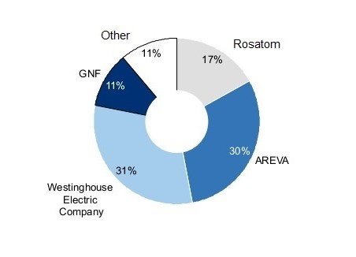
The Macroeconomic Factor:
A change in the market share of a fuel company in the global nuclear fuel market due to the advance (delay) of the industrial development of efficient ATFs
Major players in the nuclear fuel fabrication market, %
The annual turnover of the nuclear fuel market is more than $ 35 billion.
Mass introduction (or non-introduction) of ATFs may affect the macroeconomic indicators of the nuclear power engineering economy.

Slide 4
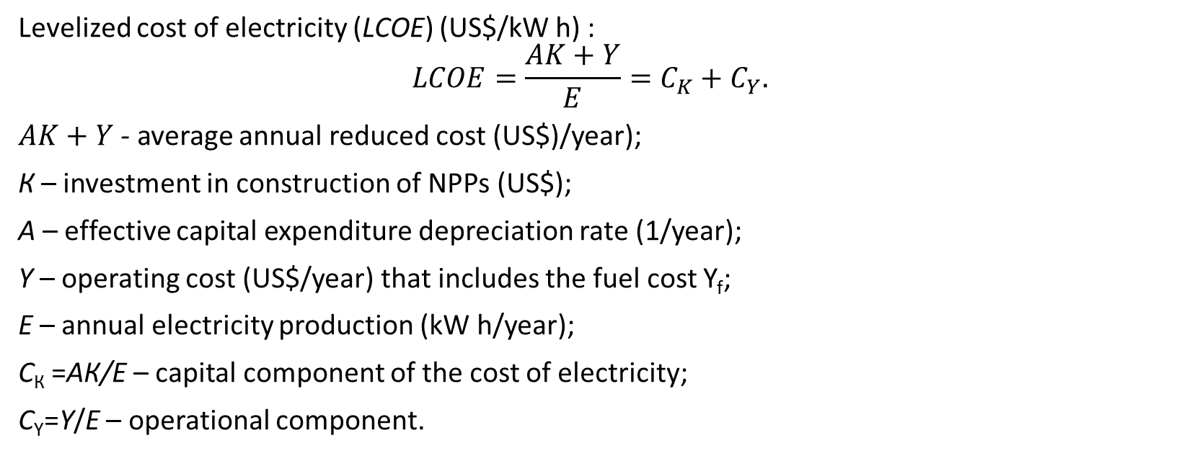
Levelized Cost of Electricity
Levelized cost of electriсity (LCOE) (US$/kW h) :
$$LCOE=\frac{AK+Y}{E}=C_{K}+C_{Y}.$$
$AK+Y$ - average annual reduced cost (US$)/year);
К – investment in construction of NPPs (US$);
А – effective capital expenditure depreciation rate (1/year);
Y – operating cost (US$/year) that includes the fuel cost Y_{f};
Е – annual electricity production (kW h/year);
С_{К} =АК/Е – capital component of the cost of electricity;
С_{Y}=Y/E – operational component.
A reactor with a rated capacity of 1200 MW with capital cost K = $ 5 billion and CF = 0.88 produces electricity of about 9 TW h per year and is characterized by a levelized cost of sold electricity LCOE = 65 US$/(MW h), which includes С_{K}=43 US$/(MW h) and С_{Y}=22 US$/(MW h) including the fuel component of 6−10 US$/(MW h) (in this case, the effective capital expenditure depreciation rate А=7,7 %/year).

Slide 5
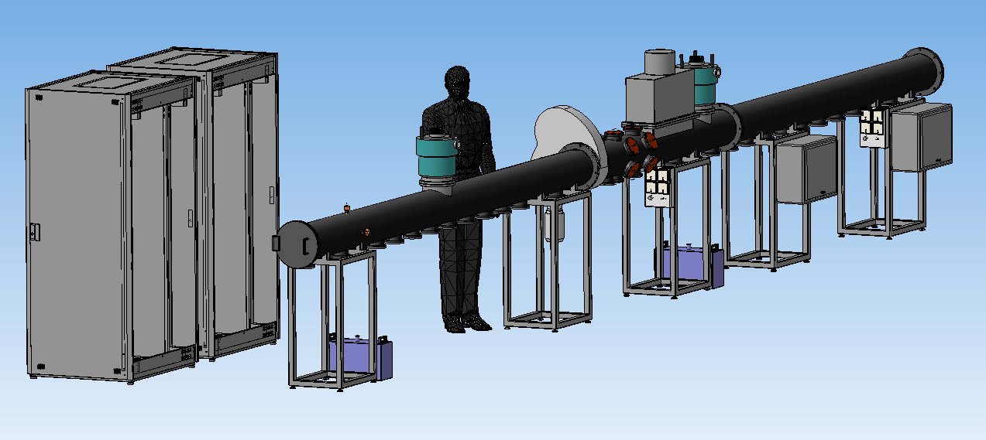
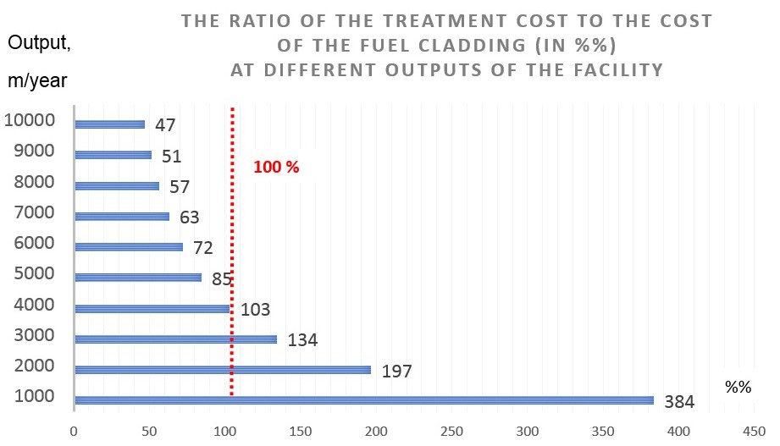
An Increase in the Cost due to Changes in Materials
Changes in materials
↓
Increase in the required fuel enrichment and the cost of separation work
↓
Increase in ATF cost
The cost of ion-beam treatment of zirconium fuel tubes for obtaining anti-corrosion wear-resistant barrier layers at the ILUR facility (NRNU MEPhI) with an output of more than 10 000 m/year is estimated at 10−15 US$/m.
The quantity of zirconium tubes that must be treated for the annual refueling of a reactor with a capacity of 1200 MW and a burnout depth of 55−70 (MW day)/kg of U is 40−50 km/year, which requires additional costs ΔY_{Т} ≈ 0.4−0.8 million US$/year.
These costs make ε=2−4% of the operating costs, which will increase the LCOE by 0,6−1,2%.

Slide 6
Cost Reduction
An increase in the CF. This means an increase of ΔЕ = μЕ in the nuclear power generation by increasing the ATF burnout depth. An increase in the ATF burnout depth helps to reduce the weight of the spent nuclear fuel (SNF), which is important for the “back-end” economy of the nuclear fuel cycle. In addition, the ATF technology may facilitate, to some extent, the approximation to the well-known “the safer the cheaper” paradigm.
Reduction of the cost of the engineering safety barriers. Since the capital component of the electricity cost is as high as 65−70%, the reduction of the capital costs due to the ATF by only i = 5% allows the electricity cost to be lowered to 4%.
Reduction of the insurance contributions from NPP revenues . The insurance rates of the Y_{ins} should take into account the probable frequency of accidents and possible economic damage. Assume that the introduction of ATF will help to reduce both the frequency of accidents and the magnitude of damage from them (e.g., due to the lack of hydrogen production), i.e., to reduce the Y_{ins} by a relative value of ψ=−ΔY_{ins}/Y

Slide 7
The impact of the ATF on possible changes in the market share of fuel companies
CURRENT SITUATION
FUTURE THREATS
An excess of the production capacity of fuel-assembly fabrication for light-water reactors (≈15 kt/year − WNA, 2017) over the needs of nuclear power (almost twofold) in the coming decades
Start of the project on the simplified licensing of alternative fuel for Russian-designed reactors (2015)
Forthcoming decommissioning of 14 WWER-440 reactors operating abroad.
- generate about 15% of the world’s nuclear power, using fuel produced in Russia.
Almost 75% of the currently operating 450 reactors in the world (minus CANDU- and WWER-type reactors) use square-type fuel assemblies of foreign companies.

Slide 8
CONCLUSIONS
The impact of the new ATF fuel on the electricity cost (at the microeconomic level) can affect both the capital and operational components.
The NPP LCOE (as well as other criteria for the efficiency of investments in NPPs) with the new ATF can be correctly assessed only with adequate calculation of the impact factors. In the particular case when i=ψ=ε=μ=7%, we obtain that LCOE = 58 US$/(MW h), which is 12% less than the LCOE of the standard unit. In other words, despite the additional costs of the ATF production, it is possible to reduce the electricity cost owing to the combination of the other impact factors.
At the current state of research in the field of the ATF technology, it is difficult to make more accurate assessments.
Facts point to a sharp increase in the competition in the global market of fuel assemblies and the expulsion of the Russian fuel company from its traditional places. If domestic enterprises are late with the production and access to the world market of square-type ATF-containing fuel assemblies and foreign fuel companies start their mass production earlier than the domestic fuel company does, the global market may be lost for us, which is fraught with a significant loss of export revenues.
ATF increases the safety of NPPs due to the passive physical and chemical properties of used materials and not due to the new active engineering safety barriers, thus implementing the principle "the safer the cheaper."

Slide 9
Thanks for your attention.

