Slide 1
11th CONFERENCE ON REACTOR MATERIAL SCIENCE
Dedicated to the 55th Anniversary of the JSC «SSC RIAR» Material Testing Complex
Classification of irradiation rigs for material testing in BOR-60 reactor
© I.Yu. Zhemkov, S.G. Eremin, A.I. Plotnikov,
N.S. Poglyad, V.Yu.Anisimov, A.V. Boev

Slide 2
Experimental devices of the BOR-60 reactor
For carrying out experimental studies and transferring of the obtained results to other reactors, it is necessary to ensure the required irradiation conditions equal to or close to the actual operating conditions of the materials. To solve this problem, special experimental devices are used, providing the necessary irradiation conditions during the whole period of testing on the reactor.
Experimental devices differ in the method of obtaining information, in the value of irradiation temperatures, in their design and in the environment in which materials are tested.

Slide 3
Experimental devices of the BOR-60 reactor

Slide 4
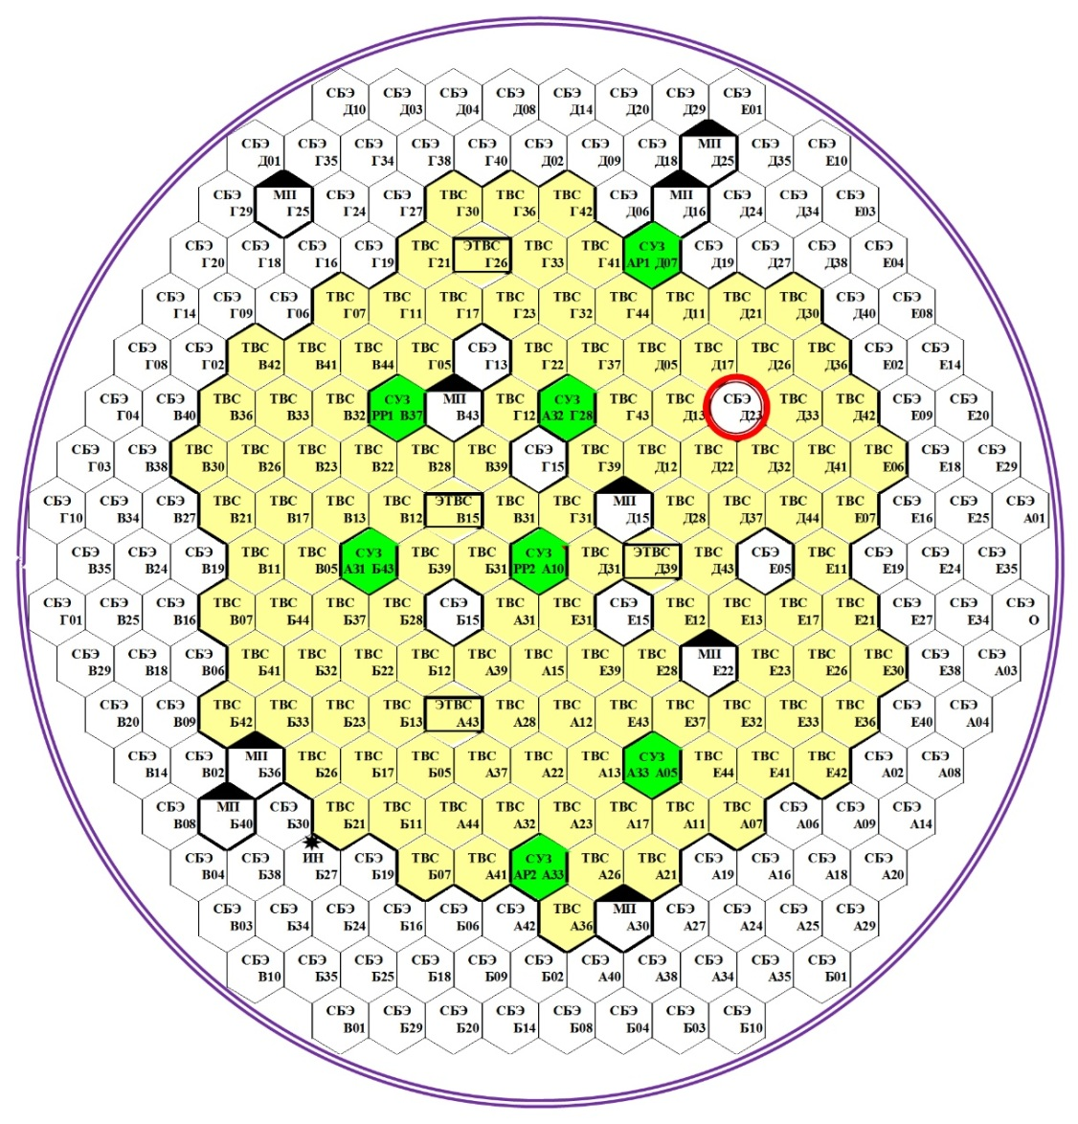
The BOR-60 core map
СУЗ – control rods;
МП – material test rigs;
ЭТВС – experimental fuel assembly;
СБЭ – blanket assembly;
instrumented cell Д23 is highlighted in red

Slide 5
Materials tested in the BOR-60 reactor
Materials | Type
Fuel | Ceramics | UO₂, UO₂-PuO₂, (U,Pu)O₂, UC, UN, UPuN, UPuCN, PuO₂-MgO, ЯТ+Np, Am
 | Metal | U, UPu, UZr, UPuZrNb, PuN-ZrN
 | Metal-ceramics | PuO₂-U, UO₂-U, UO₂-PuO₂-U, UN-U
 | Composite | (UPuZr)C, UO₂-NiCr
Absorbing | Samples | B₄C, Ta, Hf, Dy, Sm, Gd, AlB₆, AlB₁₂, Eu₂O₃, HfH_{x}, Gd₂O₃, Dy₂O₃-HfO₂
 | Control rods | CrB₂, B₄C (¹⁰B – 19÷80 %), Eu₂O₃, Eu₂O₃+ZrH₂
Constructional | Steel | OX18H9, X18H10T, ЭП450, ЭП823 03Х16Н9М2, ЭП912, ЭИ847, ЭП172, ЧС68, ВХ24, ЭП302Ш, 09Г2С, АРМКО, SS316, ODS-(12,14,18)Cr, T91, T92, S421 (НТ9), 15-15Ti, 800H, 14YWT, 800H, …
 | Refractory material | V, W, Mo, Nb, WC, SiС/SiС
 | Alloys | РЕ-16, Х20Н45М4Б, ВЦУ, Э110, Э125, Э117,Э635,VCrTi, FeCr, ZrNbSnFeO
 | Moderators | ГРП-2-125, МП6-6, ГР-280, АРВ, IG-11, ПГИ, ZrH_{х}
 | Neutron source | Po-Be, Be, Sb-Be
Coolant | Liquid metal | Na, Pb, Pb-Bi
Electrotechnical | insulation | Al₂О₃, SiO₂, Si, mica
 | cables | КТМС, КНМС(Н)
 | magnets | ЮНДК
Other materials | Special ceramic | ГБ-7, ИФ-46, ЦТС, LiNbO₃
 | Biological shield | Concrete different marks

Slide 6
Experimental fuel assembly
a) suspension for irradiating experimental fuel rods;
b) suspension for irradiating experimental fuel rods using fuel heater;
c) suspension for irradiating samples of structural materials using fuel heater;
1 – shroud shell;
2 – thermoinsulation (gas);
3 – experimental fuel rod;
4 – cassettes with samples of construction materials;
5 – fuel heater;
1
2
3
4
5
a
b
c

Slide 7
Material test rig
1
a) flow suspension;
b) non-flow suspension;
c) sealed suspension;
1 – shroud shell;
2 – thermoinsulation (gas);
3 – cassettes with samples of construction materials;
4 – nonpressurized (b) and sealed (c) container;
2
3
4
a
b
c

Slide 8
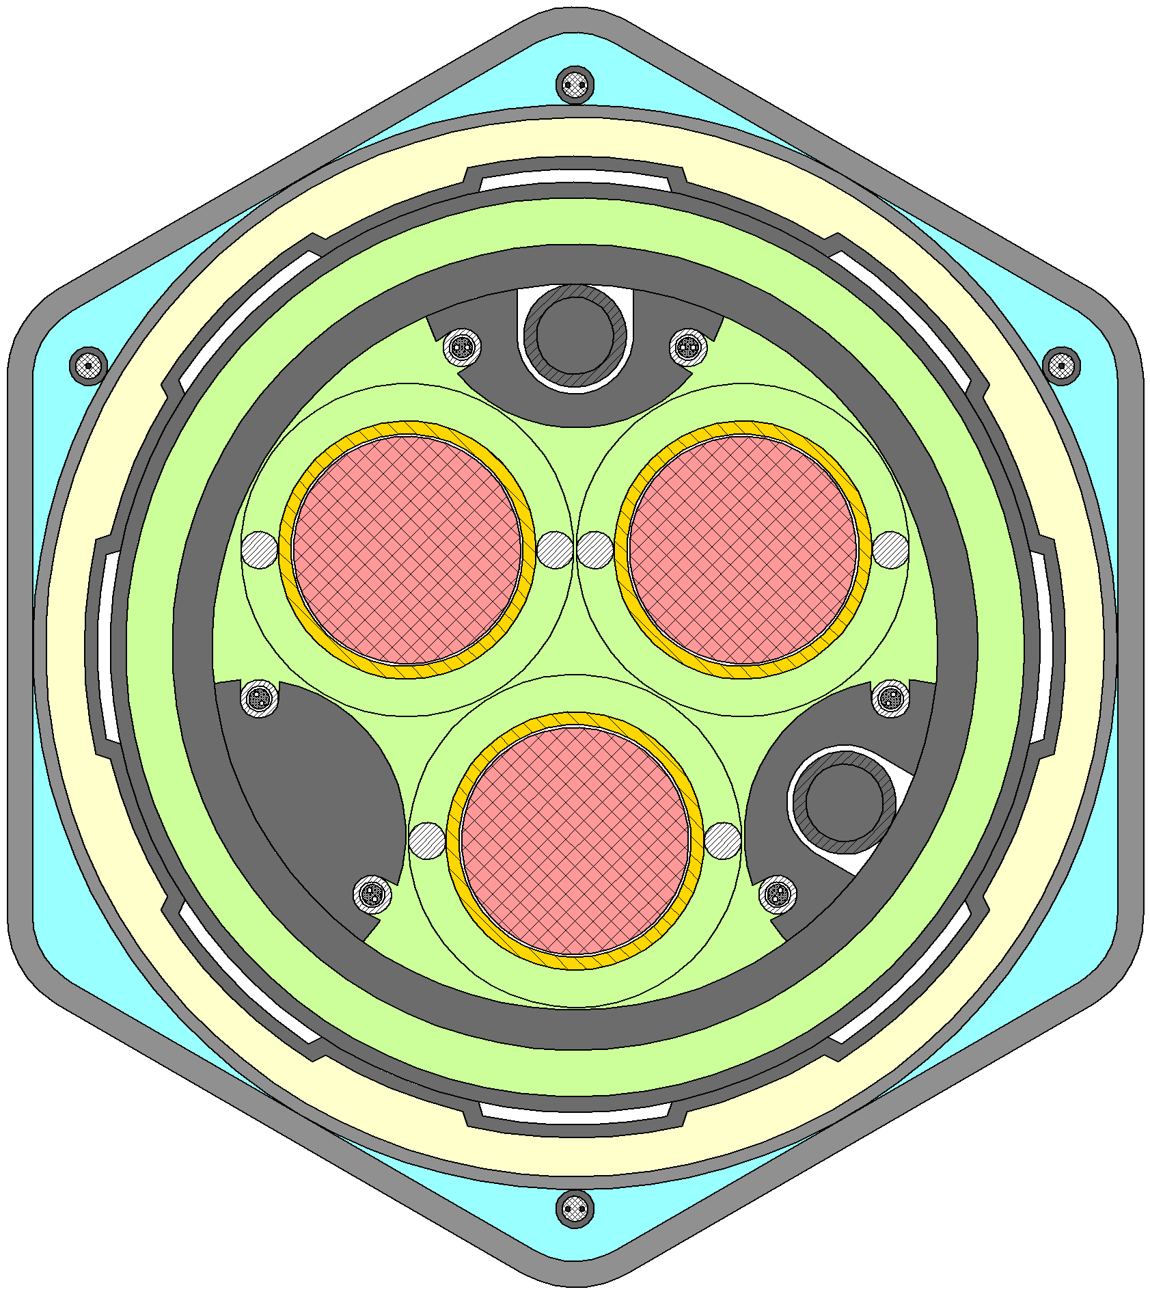
Test loop channel
1
2
3
1 – shroud shell;
2 – thermoinsulation (gas);
3 – experimental fuel rod;
4 – loop coolant;
5 – reactor coolant.
4
5

Slide 9
In the BOR-60 reactor a wide range of tests of various types of structural materials, absorbers, moderators and nuclear fuel is carried out. Each of the research areas requires an individual approach and the creation of a unique ED.
The experience gained in the BOR-60 reactor accumulated over a long history of operations makes it possible to choose the most suitable type of experimental device for each task, and the reliability of the obtained data is confirmed by computational and experimental studies.
Using computational and experimental studies on the BOR-60 reactor, designed and applied experimental devices structures, as well as the creation of new types of EDs makes it possible to maximize the experimental capabilities of the reactor and conduct new research in virtually all promising areas of nuclear power development.

Slide 10
Thank you for your attention

