Slide 1
THERMOPHYSICAL PROPERTIES OF NUCLEAR GRAPHITE IRRADIATED UP TO HIGH NEUTRON FLUENCE
© E.P. Belan and D.V. Khar’kov, 2019
ХI Reactor Material Science Conference
27 - 31 May 2019, Dimitrovgrad

Slide 2
Introduction
Graphite GR-280 has been used as the material of masonry in the RBMK reactors.
As the graphite masonry serves as a moderator and reflector of neutrons, it is an irreplaceable and partially re-buildable component of the reactor. So it affects the operational life of the power unit at large.
As evidenced by examinations of graphite kernels cut down from the graphite blocks of the RBMK masonry after a 30-year operation, the masonry is in satisfactory condition and thus the reactor can continue operation but it brings about a new task to justify an extended operating life of the masonry.
Purpose of work is to reveal high-dose neutron irradiation effect on the main thermal and physical properties of graphite GR-280 within the irradiation temperature range of 450ºC to 640 °С up to attaining a neutron fluence of 3.3⋅10²⁶ m⁻².
The samples for irradiation test (∅8×30 mm in size) were cut out from standard graphite blocks intended for use in the RBMK reactors.
The graphite samples were under irradiation in the 4th ring of the BOR-60 core (neutron flux density was 1.5⋅10¹⁹ m⁻²⋅s⁻¹) at temperatures of 450ºC, 560ºC and 640 °С to attain neutron fluence of (0.1 ÷ 3.2)·10²⁶ m⁻² (Е_{n}>0.18 MeV).

Slide 3
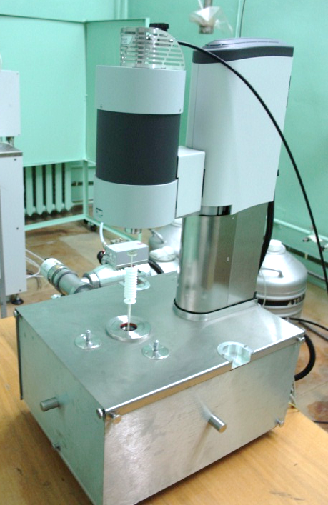
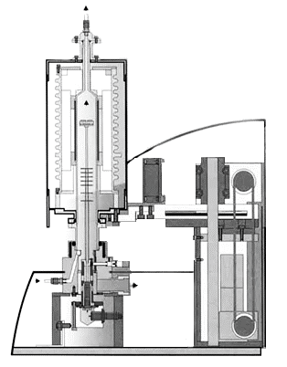
Post-irradiation examination methods
Measurement of specific heat capacity and stored energy
Application of DSC method with the use of DSC 404 C Pegasus calorimeter.
Where с_{р}, с_{рref.} are heat capacity values of the sample under examination and reference sample; m_{ref.}, m_{s} are masses of reference and graphite samples; DSC_{баз.}, DSC_{ref.}, DSC_{s.} are difference in readings of micro thermal sensing elements when empty crucible, reference and graphite samples are measured .
A measurement error was 3 %.
dS/dТ = а⁻¹·(DSC₂ – DSC₁)
dS/dТ is a rate of stored energy release; а is a rate of temperature variation; DSC₁ and DSC₂ are differences in readings of micro thermal sensing elements when the first and second measurements were taken.
A measurement error was 3.5 %.
Schematic representation of DSC 404 C Pegasus

Slide 4
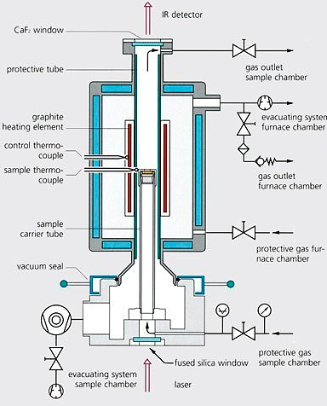
Post-irradiation examination methods
Thermal conductivity coefficient of samples was obtained by the following formula:
λ = а·ρ·с_{p},
where λ is thermal conductivity coefficient; а is thermal diffusivity; ρ is density; с_{p} is specific heat capacity.
Measurement of thermal diffusivity
This value was obtained with the use of laser flash method and laser flash apparatus LFA 427. The measurement error was 2.5 %.
а = (1.38×h²)/( π² × τ_{1/2} )
where а is thermal diffusivity, h is a sample thickness, τ_{1/2} is the heating time of the back side of the sample so that to achieve a half of the peak temperature; 1.38 is a non-dimensional coefficient.
Schematic representation of facility

Slide 5
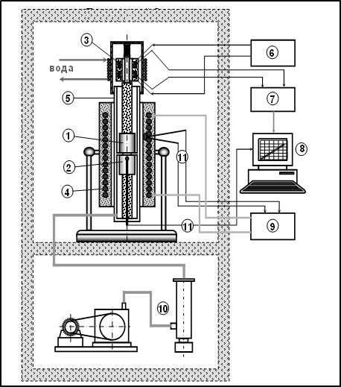
Post-irradiation examination methods
Measurement of thermal linear expansion coefficient
temperature range of 50 ÷ 600°C;
in the environment of helium;
with continuous measurement of sample elongation by inductive displacement transducer with accuracy of 1 µm.
1 – sample; 2 – reference sample; 3 – inductive displacement transducer; 4 – heating element; 5–vacuum enclosure (quartz tube); 6 – power source; 7 – signal transducer; 8 – PC; 9 – furnace control console; 10 – vacuum system; 11 – thermocouples
Schematic representation of facility

Slide 6
Specific heat capacity and thermal conductivity coefficient
Where λ is thermal conductivity coefficient, W/(m·K); Сp – specific heat capacity, J/(g·K); А is geometric factor, g/m²; υ is wave propagation velocity of lattice, m/s; l is free path length of phonon, m
Figure 1. Specific heat capacity of initial and irradiated graphite GR-280 and initial graphite POCO against the measurement temperature.
The specific heat capacity of initial and irradiated samples differs by 6% at the highest within the whole measurement temperature range and so the values are within the measurement error.
Figure 2. Thermal conductivity coefficient of irradiated and initial graphite against the measurement temperature.

Slide 7
Thermal conductivity coefficient in relation to neutron fluence and irradiation temperature
Figure 3. Percentage change of the GR-280 thermal conductivity coefficient in relation to neutron fluence.
Figure 4. The GR-280 thermal conductivity coefficient in relation to irradiation temperature.

Slide 8
Thermal linear expansion coefficient (TCLE) in relation to neutron fluence and irradiation temperature
TCLE values averaged within a temperature range of 25ºC to 400 °С
TCLE of crystalline particles does not change compared with their initial values when irradiation testing is conducted at temperatures higher than 300 °С.
Figure 5. TCLE of graphite exposed to irradiation testing at 450 °С (a), 560 °С (b), and 640 °С (c) in relation to neutron fluence.

Slide 9
Rate of stored energy release
Figure 6. Rate of stored energy release in annealing of graphite samples irradiated at 450 °С (a) and 640 °С (b) in relation to annealing temperature.

Slide 10
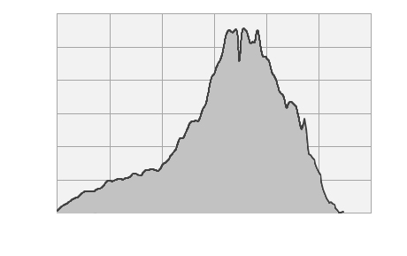
Total stored energy
Figure 7. Rate of stored energy release during dynamic and isothermal annealing.
Total stored
energy (S)
dS/dt
Figure 9. Total stored energy (S) released in annealing of irradiated samples within a temperature range of 20 ÷ 1300 °С in relation to neutron fluence.
Annealing time
Figure 8. Schematic representation of total stored energy estimation.

Slide 11
Thermal conductivity coefficient of graphite before and after annealing
Debye equation:
Figure 10. Thermal conductivity coefficient of initial and irradiated graphite before and after annealing in relation to measurement temperature.
Figure 11. Percentage change of thermal conductivity coefficient of the sample in relation to the annealing temperature.

Slide 12
Annealing time effect
Straight-line relation;
Rate of change λ is 1.5 W/(m·K) per hour.
Figure 12. Thermal conductivity coefficient in relation to annealing time at 1200 °С.
Figure 13. Rate of stored energy release in relation to annealing time.

Slide 13
Annealing time effect
● - measurement data
··· - extrapolation
Figure 14. Thermal conductivity coefficient in relation to measurement temperature.

Slide 14
Conclusions
1. These experiments made it possible to obtain thermal conductivity coefficient (λ) of graphite GR-280, irradiated in a temperature range of 450 ÷ 650 °С up to attaining neutron fluence of 5 ÷ 32·10²⁵ m⁻² in relation to a measurement temperature of 25 ÷ 1200 °С.
The graph λ_{irr.} (at Т_{test}=Т_{irr.} ) in relation to neutron fluence reveals three stages: the first stage (0 ÷ 5⋅10²⁵ m⁻²) is characterized by a drastic decrease in ∆λ/λ_{initial} that is roughly 55 %; the second stage (5⋅10²⁵ m⁻² ÷ 15⋅10²⁵ m⁻²) is distinguished by a minor change in ∆λ/λ_{initial} and it is equal to roughly 5 %, and the third stage (higher than 15⋅10²⁵ m⁻²) that exhibits a rapid decrease in ∆λ/λ_{initial} compared to the second stage.
2. It was shown that change in TCLE as a function of neutron fluence reveals 3 stages: the TCLE value tends to increase within the initial section that does not exceed 20 % up to neutron fluence of ∼ (0.5-0.7)⋅10²⁶ m⁻² and then TCLE tends to decrease but it tends to increase againt at neutron fluence values higher than Ф_{кр}.
The effect of texture on TCLE was revealed: values α are equal to 3.5 in the initial condition and 4.5⋅10⁻⁶ 1/K for graphite samples of parallel and perpendicular cutting, respectively but difference in TCLE values in the perpendicular and parallel directions remains almost the same under irradiation within the entire range of neutron fluence and is roughly 1⋅10⁻⁶ 1/K.

Slide 15
Conclusions
3. The total stored energy released in annealing within a temperature range from graphite irradiation temperature and up to 1300 °С (irradiated at 450 °С and 640 °С) reaches a constant level at neutron fluence roughly (0.7 ÷ 1.5)·1026 m⁻². The peak value of total stored energy is roughly 200 J/g at Т_{irr.} = 450 °С and is roughly 180 J/g at Т_{irr.} = 640 °С. The rate of stored energy release is the maximal one at a temperature of post-irradiation annealing of 1100°С.
4. It was shown that thermal conductivity coefficient of graphite GR-280 irradiated at Т_{irr.} = 450 ÷ 640 °С up to neutron fluence of (0.5 ÷ 1.5)⋅10²⁶ m⁻² increases by 19 ÷ 39 W/(m⋅K) (at an ambient temperature) because of thermal annealing at 1200 °С for 2 h. Annealing effect given in absolute values tends to decrease within the above given range of irradiation test parameters as the neutron fluence and irradiation temperature increase but the ratio of thermal conductivity coefficient obtained before and after annealing is a constant value equal to 2.3.

Slide 16
THANK YOU FOR YOUR ATTENTION!

